Slide 1


Vidya Prasarini Sabha’s
College of Engineering And Technology, Lonavala
CAMPUS PLACEMENT PREDICTION AND ANALYSIS
FINAL REVIEW
Guide Name:
Dr. Manav A. Thakur Sir
Group Members:
Rushikesh Joshi
Roshan Dandge
Vijay Shilwant
Shreyash Rajput

Slide 2
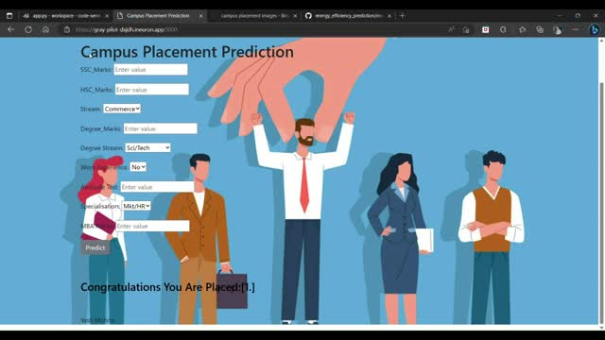
INDEX
Abstract
Introduction
Purpose
Existing System
Proposed System
Objective
App Features
Beneﬁts for Students
Beneﬁts for Institutions
Challenges
Future Enhancements
Conclusion

Slide 3
ABSTRACT
The "Campus Placement Prediction Android Application" is a user-friendly mobile app designed to aid students and placement officers in the campus recruitment process. Students can create profiles with academic details and skills, receiving insights to identify their strengths and weaknesses.
Placement officers can access the app to search for potential candidates, viewing a ranked list of suitable students. Real-time notifications keep users informed about job openings and events. Interactive workshops and webinars enhance students' skills and industry knowledge. The app prioritizes data security and offers an intuitive interface for seamless navigation.

Slide 4

Introduction
Welcome to the presentation on From Campus to Career: Predicting Placement with Android App. In this casual presentation, we will explore how android application can help predict job placements for students. Let's dive in!

Slide 5
PURPOSE
On the placement officer's end, the application revolutionizes candidate selection. It employs historical placement data and android application to rank candidates based on their predicted placement success.
Overall, the purpose of the "Campus Placement Prediction Android Application" is to bridge the gap between students and placement officers, By empowering students to enhance their profiles and aiding placement officers in identifying the best-fit candidates.
The purpose of the "Campus Placement Prediction Android Application" is to fundamentally transform the traditional campus recruitment landscape by harnessing the power of data-driven insights and predictive analytics.
For students, the app serves as a guiding light, By analyzing their academic performance, skills, and other relevant attributes, the app predicts the likelihood of their placement success. Additionally, the app provides personalized recommendations, enabling students to make informed about skill enhancement and career choices , also driven opportunities.

Slide 6

EXISTING SYSTEM
The current campus placement prediction system, often relying on Excel sheets, presents several challenges due to its manual and spreadsheet-based nature. Using Excel for this purpose introduces issues such as data complexity, error-prone manual data entry, and scalability limitations. Advanced analytics and real-time updates are also lacking, leading to inaccurate predictions and delayed information dissemination.

Slide 7

PROPOSED SYSTEM
The proposed system for the "Campus Placement Prediction Android Application" envisions a game-changing approach to campus placements, leveraging modern technology and user-friendly design. This system will empower students and recruiters alike through its key features.
Recruiters will benefit from a specialized dashboard that simplifies candidate search, displaying a ranked list of potential candidates based on their predicted placement success. Real-time notifications will keep both students and recruiters informed about relevant events and job openings.

Slide 8
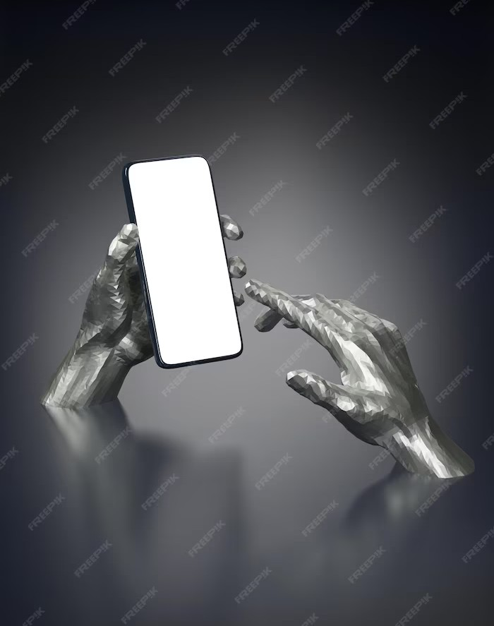
Objective
Our objective is to develop an Android app that utilizes android application to predict the career placement of college students. By analyzing various factors such as academic performance, internships, and extracurricular activities, we aim to provide valuable insights to students and help them make informed decisions about their future career paths.

Slide 9

Why Predict Placement?
Predicting placement can assist students in making well-informed decisions about their career paths. It allows them to focus on areas that improve their chances of success and helps educational institutions tailor their programs to meet industry demands. Our Android app aims to bridge the gap between campus life and professional careers, empowering students to make conﬁdent choices.

Slide 10

Data Collection
To develop our prediction model, we collect data from various sources such as student records, internship databases, and industry trends. We ensure data privacy and anonymization to protect the students' identities. By leveraging this diverse dataset, our android application can identify patterns and correlations to make accurate placement predictions.

Slide 11

App Features
Our Android app offers a range of features to assist students in their career planning journey. It includes personalized recommendations based on the predicted placement, access to industry insights and trends, resume building tools, and internship matching. The user-friendly interface ensures a seamless experience, making it a must-have tool for students transitioning from campus to career.

Slide 12
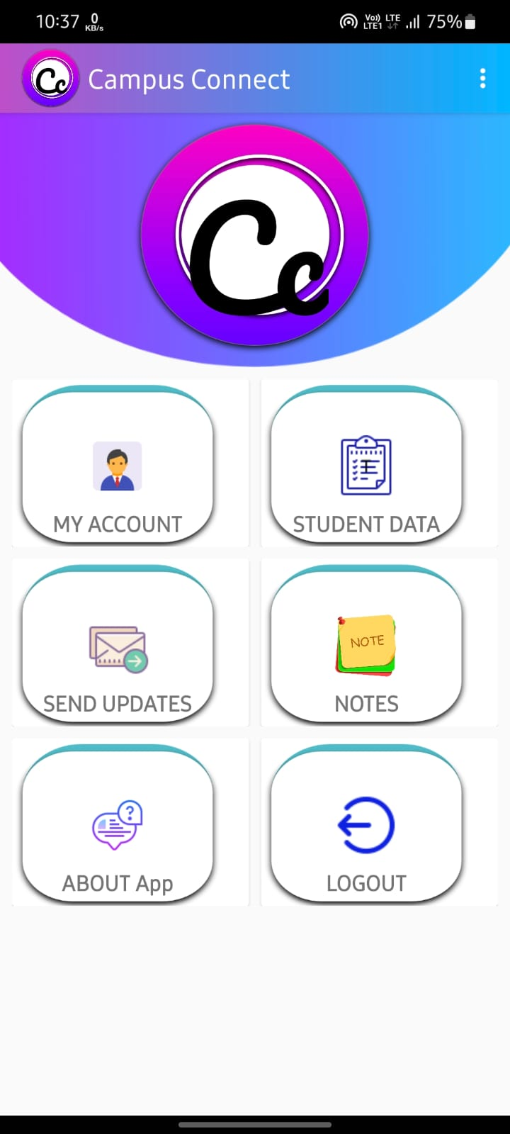
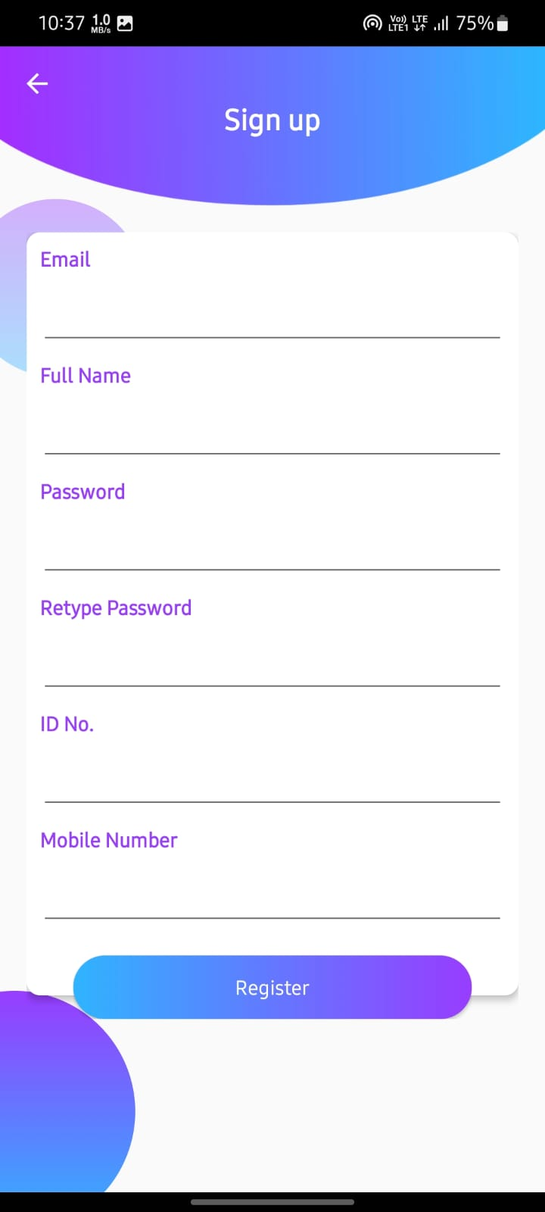
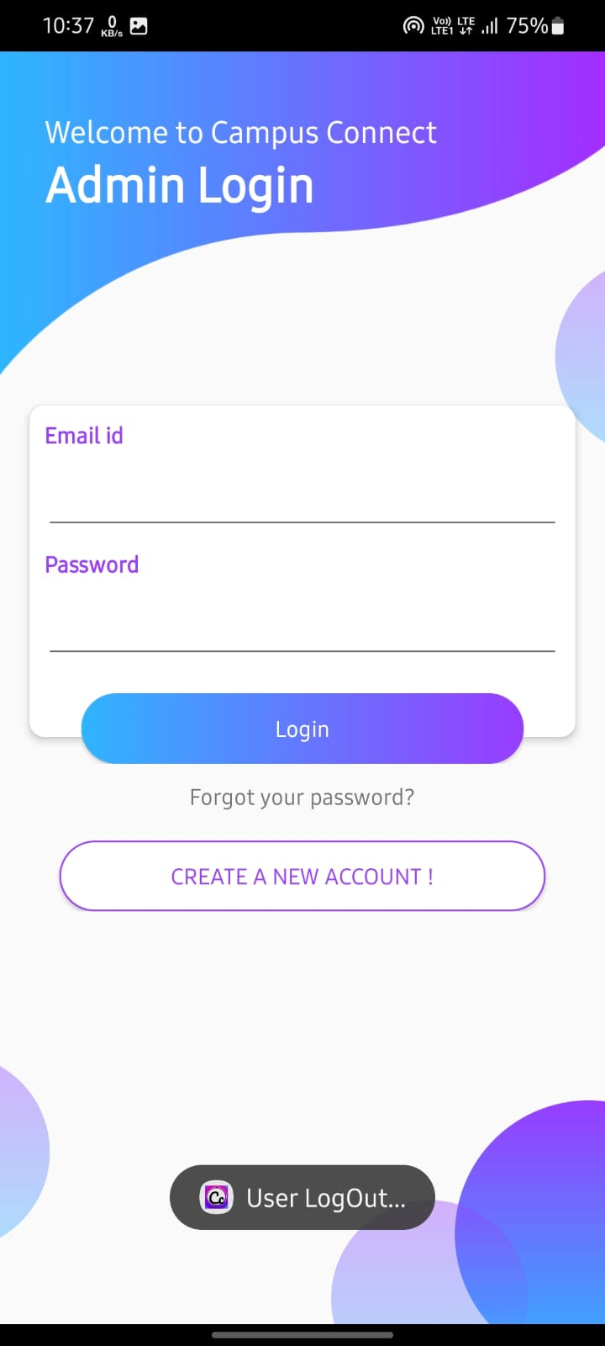
SOME FEATURES OF ADMIN APP
ADMIN DASHBOARD
ADMIN SIGNUP
ADMIN LOGIN PAGE

Slide 13
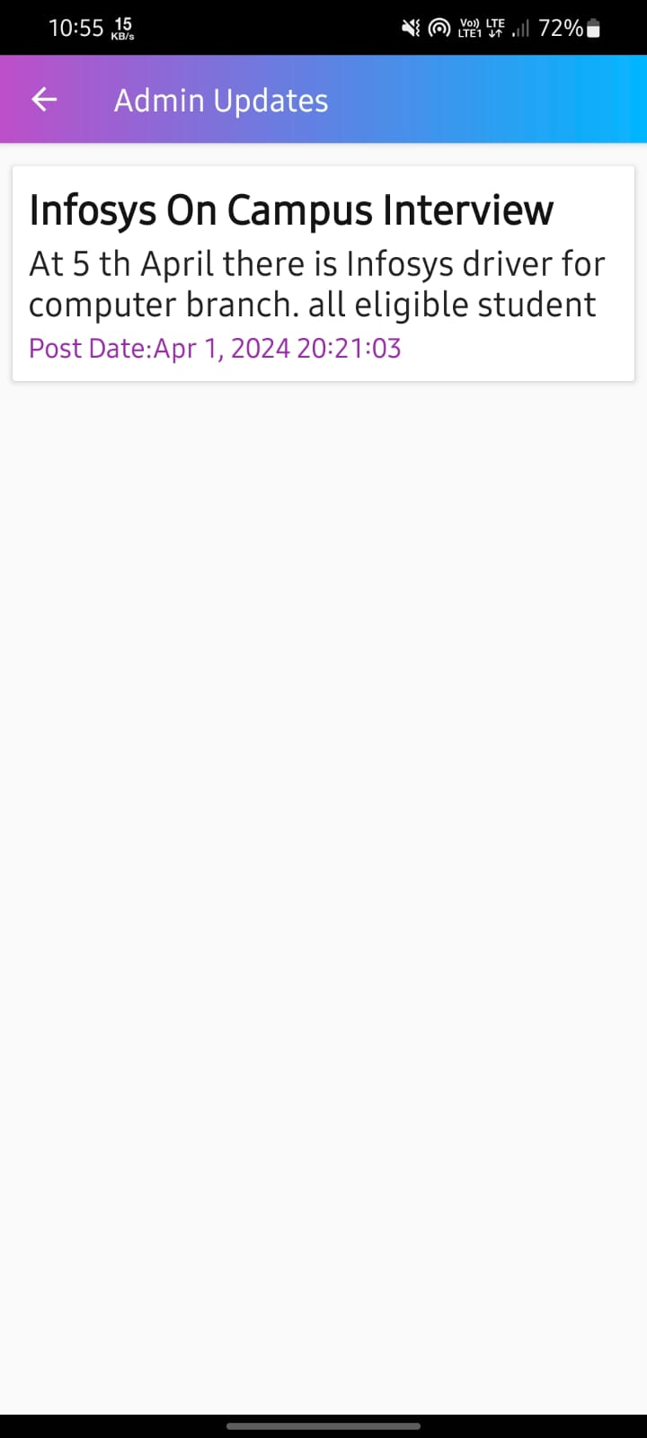
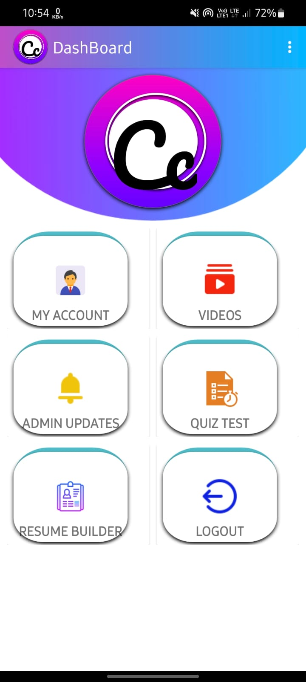
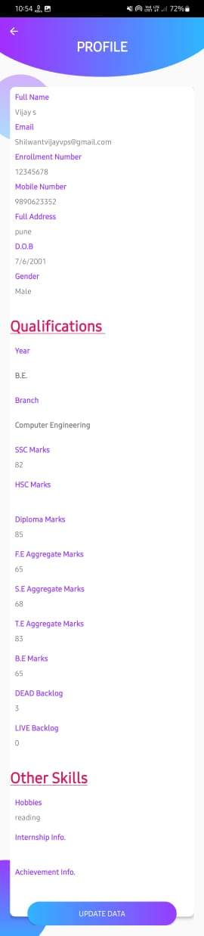
STUDENT SIDE APPLICATION
Admin update
Home screen
Student Profile

Slide 14

Data Collection and Pre-Processing
For campus placement prediction. Gathering relevant data on student proﬁles, academic performance, and past placements is essential. Preprocessing includes cleaning, transforming, and normalizing the data for accuracy and consistency. These steps set the stage for accurate prediction models and informed decision-making placements in campus.

Slide 15

Beneﬁts for Students
By using our app, students can gain several beneﬁts. They can make informed decisions about their career paths, focus on areas that improve their chances of placement, and gain insights into industry demands. The app empowers students to take control of their future and increases their chances of ﬁnding a fulﬁlling career
after graduation.

Slide 16
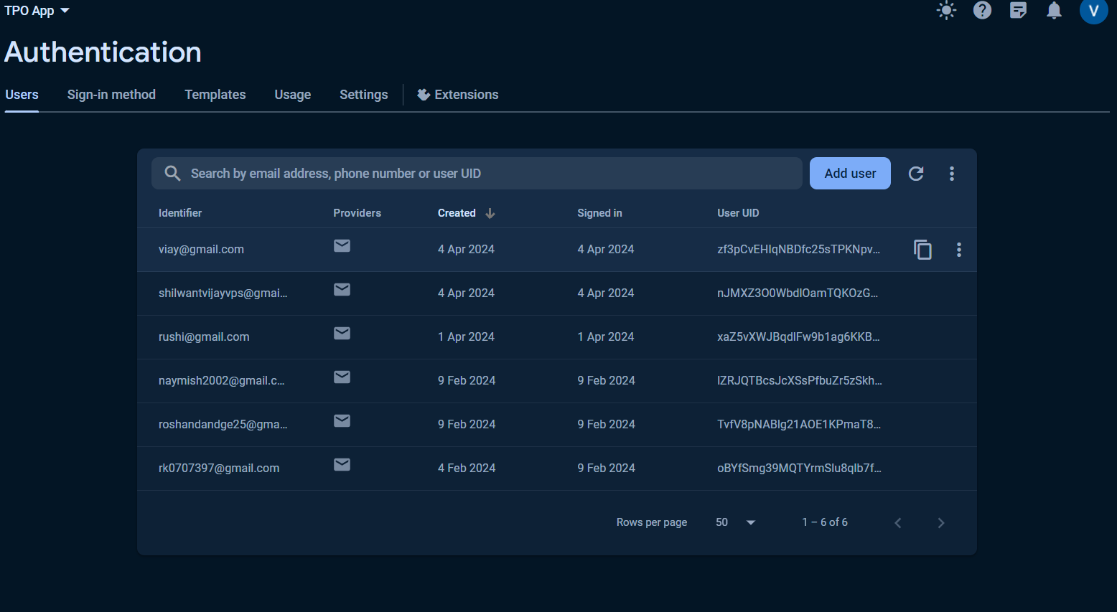
FIREBASE AUTHENTICATION

Slide 17

Beneﬁts for Institutions
Educational institutions can also beneﬁt from our app. By understanding the factors that contribute to successful placements, institutions can tailor their programs to better align with industry requirements. This leads to higher placement rates, improved reputation, and stronger relationships with industry partners.
Our app helps institutions stay ahead in
providing quality education and preparing students for the job market.

Slide 18

Challenges
Developing a placement prediction app comes with its own set of challenges. Some of these challenges include acquiring accurate and diverse data, ensuring data privacy, and continuously updating the app with the latest industry trends. However, by addressing these challenges, we can create a powerful tool that revolutionizes the way students approach their career paths.

Slide 19

Future Enhancements
As we look ahead, we envision several future enhancements for our Android app. These include incorporating real-time job market data, expanding the prediction models to cover different industries, and integrating feedback and success stories from users. By continuously improving and adapting our app, we aim to provide the most accurate and valuable predictions for students.

Slide 20
Conclusion
In conclusion, our Android app, From Campus to Career: Predicting Placement with android application, aims to empower students by providing accurate placement predictions and valuable career insights. By leveraging android application , we bridge the gap between campus life and professional careers, helping students make informed decisions.
Together, let's redeﬁne the transition from campus to career!

Slide 21
THANK YOU!

